Slide 1

Big Data Infrastructure
CS 489/698 Big Data Infrastructure (Winter 2017)
Week 2: MapReduce Algorithm Design (1/2)
January 10, 2017
Jimmy Lin
David R. Cheriton School of Computer Science
University of Waterloo
These slides are available at http://lintool.github.io/bigdata-2017w/
This work is licensed under a Creative Commons Attribution-Noncommercial-Share Alike 3.0 United States See http://creativecommons.org/licenses/by-nc-sa/3.0/us/ for details

Slide 2

Remember: Assignment 0 due 1pm Thursday – you must tell us if you wish to take the late penalty.
Source: Wikipedia (The Scream)

Slide 3


Slide 4


Slide 5


Slide 6

The datacenter is the computer!
Source: Google

Slide 7

Aside: Cloud Computing
Source: Wikipedia (Clouds)

Slide 8
The best thing since sliced bread?
Before clouds…
Grids
Connection machine
Vector supercomputers
…
Cloud computing means many different things:
Big data
Rebranding of web 2.0
Utility computing
Everything as a service

Slide 9
Rebranding of web 2.0
Rich, interactive web applications
Clouds refer to the servers that run them
Javascript! (ugh)
Examples: Facebook, YouTube, Gmail, …
“The network is the computer”: take two
User data is stored “in the clouds”
Rise of the tablets, smartphones, etc. (“thin clients”)
Browser is the OS

Slide 10
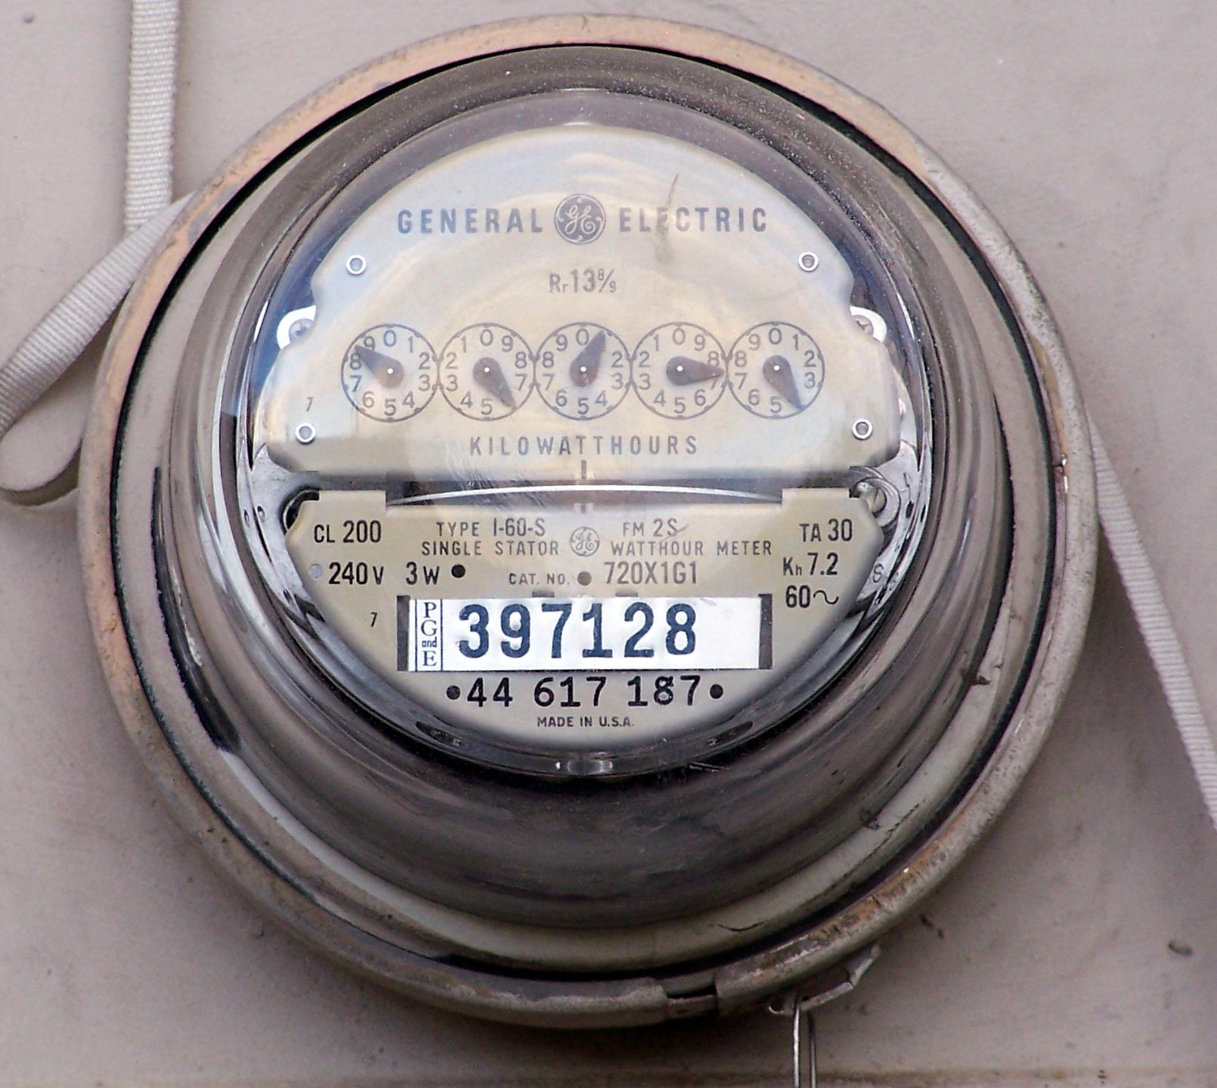
Source: Wikipedia (Electricity meter)

Slide 11
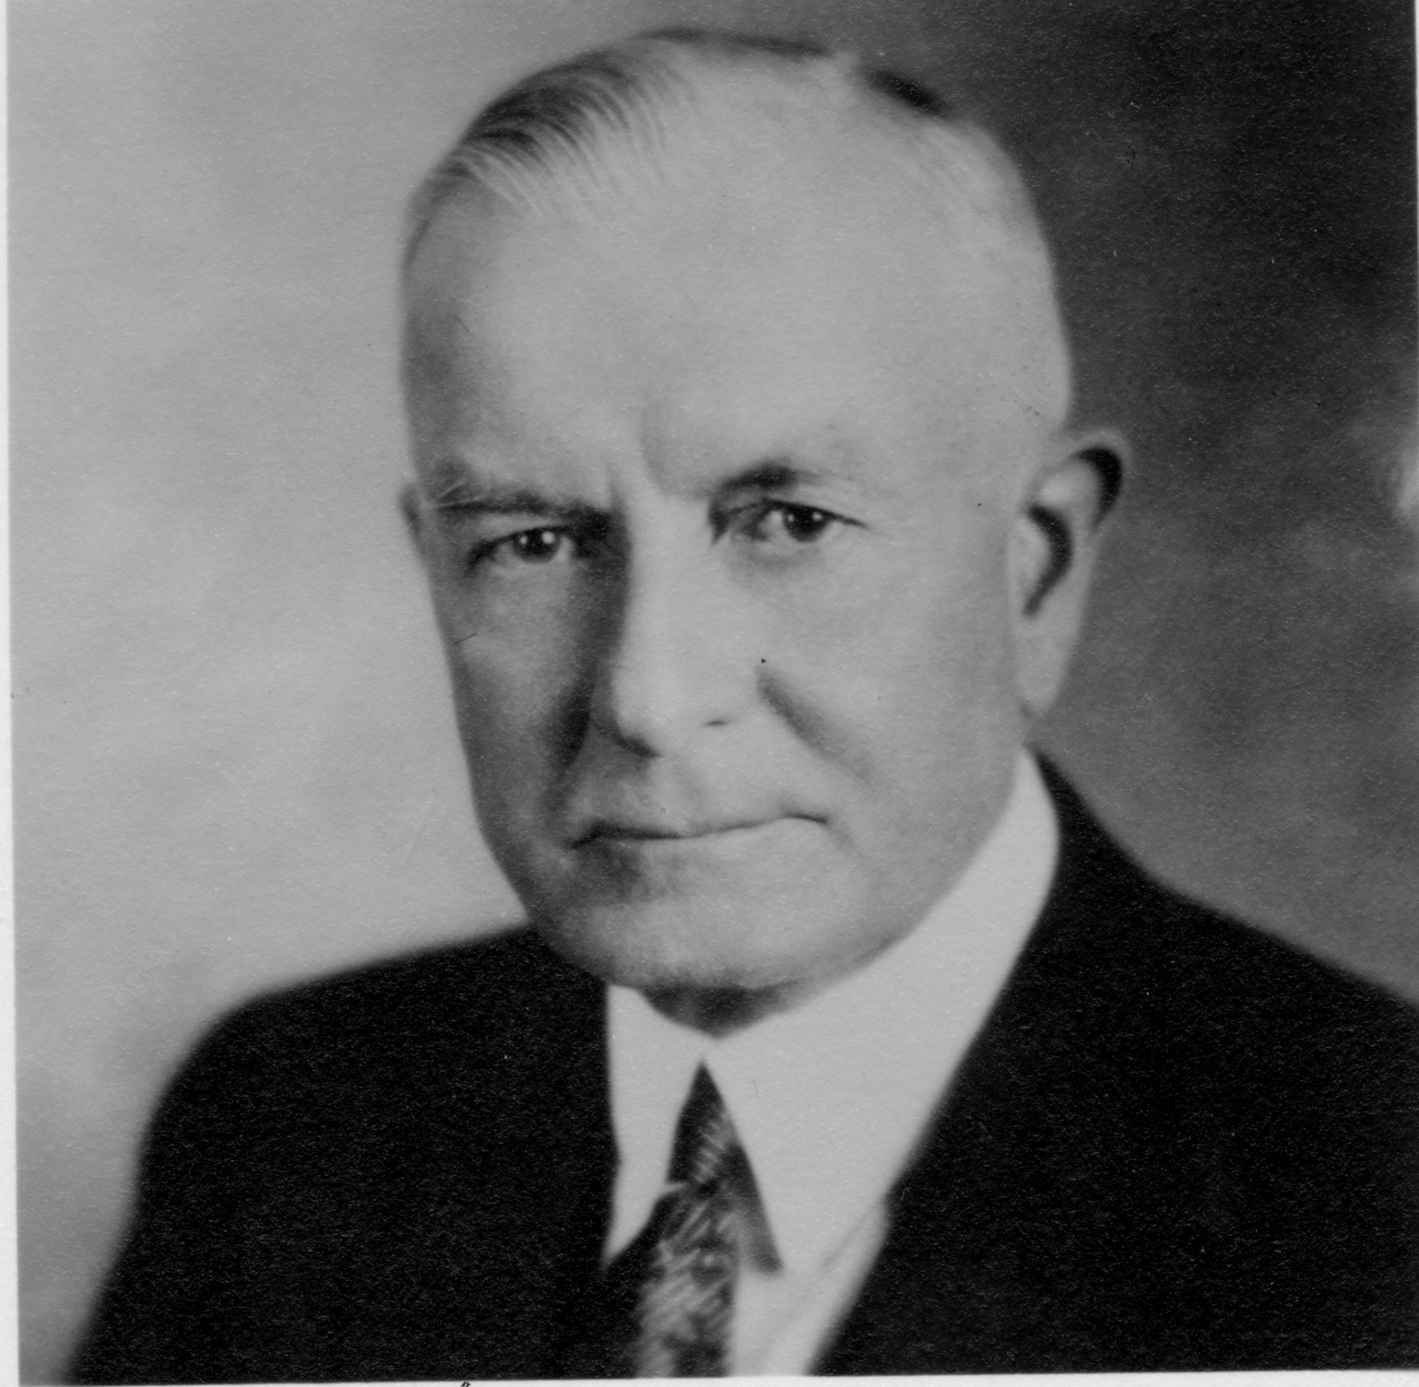
Utility Computing
What?
Computing resources as a metered service (“pay as you go”)
Why?
Cost: capital vs. operating expenses
Scalability: “infinite” capacity
Elasticity: scale up or down on demand
Does it make sense?
Benefits to cloud users
Business case for cloud providers
I think there is a world market for about five computers.

Slide 12
Evolution of the Stack
App
App
App
App
App
App
App
App
App
OS
OS
OS
Container
Container
Container
Operating System
Hypervisor
Operating System
Hardware
Hardware
Hardware
Traditional Stack
Virtualized Stack
Containerized Stack

Slide 13
Everything as a Service
Infrastructure as a Service (IaaS)
Why buy machines when you rent them instead?
Examples: Amazon EC2, Microsoft Azure, Google Compute
Platform as a Service (PaaS)
Give me nice platform and take care of maintenance, upgrades, …
Example: Google App Engine, Altiscale
Software as a Service (SaaS)
Just run the application for me!
Example: Gmail, Salesforce

Slide 14
Everything as a Service
Database as a Service
Run a database for me
Examples: Amazon RDS, Microsoft Azure SQL
Container as a Service
Run this container for me
Example: Amazon EC2 Container Service, Google Container Engine
Function as a Service
Run this function for me
Example: Amazon Lambda, Google Cloud Functions

Slide 15
Who cares?
A source of problems…
Cloud-based services generate big data
Clouds make it easier to start companies that generate big data
As well as a solution…
Ability to provision clusters on-demand in the cloud
Commoditization and democratization of big data capabilities

Slide 16
So, what is the cloud?
Source: Wikipedia (Clouds)

Slide 17

What is the Matrix?
Source: The Matrix - PPC Wiki - Wikia

Slide 18
The datacenter is the computer!
Source: Google

Slide 19
k₁
v₁
k₂
v₂
k₃
v₃
k₄
v₄
k₅
v₅
k₆
v₆
map
map
map
map
a
1
b
2
c
3
c
6
a
5
c
2
b
7
c
8
combine
combine
combine
combine
a
1
b
2
c
9
a
5
c
2
b
7
c
8
partition
partition
partition
partition
Shuffle and Sort: aggregate values by keys
a
1
5
b
2
7
c
c
2
2
9
3
8
6
8
reduce
reduce
reduce
r₁
s₁
r₂
s₂
r₃
s₃

Slide 20
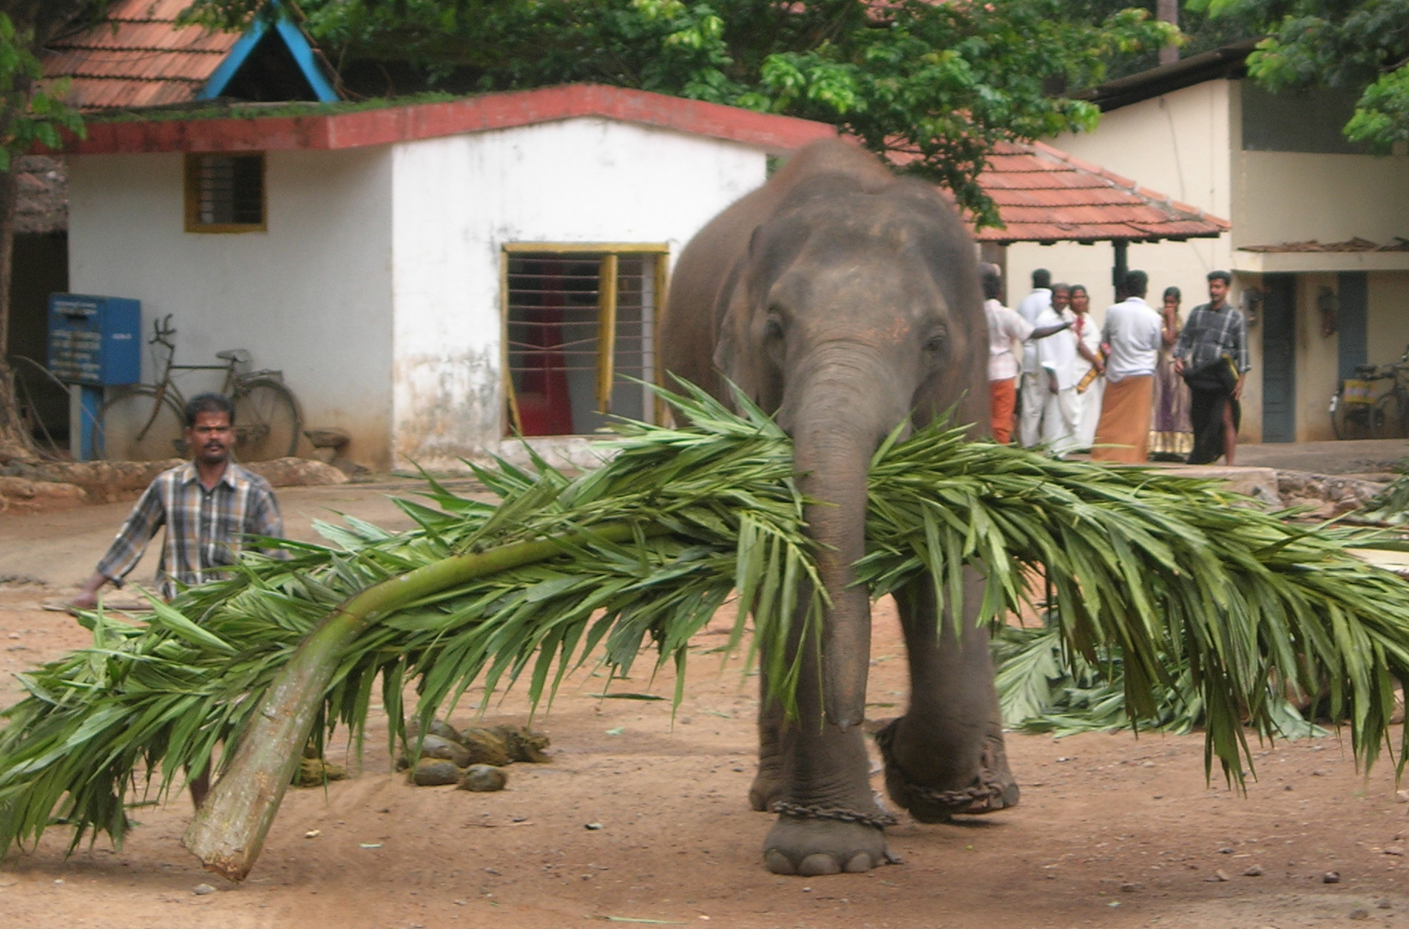

So you want to drive the elephant!
Source: Wikipedia (Mahout)

Slide 21

So you want to drive the elephant!
Aside, what about Spark?

Slide 22

A tale of two packages…
org.apache.hadoop.mapreduce
org.apache.hadoop.mapred
Source: Wikipedia (Budapest)

Slide 23
MapReduce API*
Mapper<K_{in},V_{in},K_{out},V_{out}>
void setup(Mapper.Context context)
Called once at the start of the task
void map(K_{in} key, V_{in} value, Mapper.Context context)
Called once for each key/value pair in the input split
void setup(Mapper.Context context)
Called once at the end of the task
Reducer<K_{in},V_{in},K_{out},V_{out}>/Combiner<K_{in},V_{in},K_{out},V_{out}>
void setup(Reducer.Context context)
Called once at the start of the task
void reduce(K_{in} key, Iterable<V_{in}> values, Reducer.Context context)
Called once for each key
void cleanup(Reducer.Context context)
Called once at the end of the task
*Note that there are two versions of the API!

Slide 24
MapReduce API*
Partitioner<K, V>
int getPartition(K key, V value, int numPartitions)
Returns the partition number given total number of partitions
Job
Represents a packaged Hadoop job for submission to cluster
Need to specify input and output paths
Need to specify input and output formats
Need to specify mapper, reducer, combiner, partitioner classes
Need to specify intermediate/final key/value classes
Need to specify number of reducers (but not mappers, why?)
Don’t depend of defaults!
*Note that there are two versions of the API!

Slide 25
Data Types in Hadoop: Keys and Values
Writable
Defines a de/serialization protocol. Every data type in Hadoop is a Writable.
WritableComprable
Defines a sort order. All keys must be of this type (but not values).
IntWritable LongWritable
Text
…
Concrete classes for different data types.
Note that these are container objects.
SequenceFile
Binary-encoded sequence of key/value pairs.

Slide 26
“Hello World” MapReduce: Word Count
map(string docid, string text):
for each word w in text:
Emit(w, 1);
reduce(string term, iterator<int> values):
int sum = 0;
for each v in values:
sum += v;
emit(term, sum);

Slide 27
Word Count Mapper
private static final class MyMapper
extends Mapper<LongWritable, Text, Text, IntWritable> {
private final static IntWritable ONE = new IntWritable(1);
private final static Text WORD = new Text();
@Override
public void map(LongWritable key, Text value, Context context)
throws IOException, InterruptedException {
for (String word : Tokenizer.tokenize(value.toString())) {
WORD.set(word);
context.write(WORD, ONE);
}
}
}

Slide 28
Word Count Reducer
private static final class MyReducer
extends Reducer<Text, IntWritable, Text, IntWritable> {
private final static IntWritable SUM = new IntWritable();
@Override
public void reduce(Text key, Iterable<IntWritable> values,
Context context) throws IOException, InterruptedException {
Iterator<IntWritable> iter = values.iterator();
int sum = 0;
while (iter.hasNext()) {
sum += iter.next().get();
}
SUM.set(sum);
context.write(key, SUM);
}
}

Slide 29
Three Gotchas
Avoid object creation
Execution framework reuses value object in reducer
Passing parameters via class statics doesn’t work!

Slide 30
Getting Data to Mappers and Reducers
Configuration parameters
Pass in via Job configuration object
“Side data”
DistributedCache
Mappers/reducers read from HDFS in setup method

Slide 31
Complex Data Types in Hadoop
How do you implement complex data types?
The easiest way:
Encoded it as Text, e.g., (a, b) = “a:b”
Use regular expressions to parse and extract data
Works, but janky
The hard way:
Define a custom implementation of Writable(Comprable)
Must implement: readFields, write, (compareTo)
Computationally efficient, but slow for rapid prototyping
Implement WritableComparator hook for performance
Somewhere in the middle:
Bespin (via lin.tl) offers various building blocks

Slide 32
Basic Cluster Components*
On the master:
Namenode (NN): master node for HDFS
Jobtracker (JT): master node for job submission
On each of the slave machines:
Tasktracker (TT): contains multiple task slots
Datanode (DN): serves HDFS data blocks
* Not quite… leaving aside YARN for now

Slide 33
Putting everything together…
namenode
job submission node
namenode daemon
jobtracker
tasktracker
tasktracker
tasktracker
datanode daemon
datanode daemon
datanode daemon
Linux file system
Linux file system
Linux file system
…
…
…
slave node
slave node
slave node

Slide 34
Anatomy of a Job
Hadoop MapReduce program = Hadoop job
Jobs are divided into map and reduce tasks
An instance of a running task is called a task attempt
Each task occupies a slot on the tasktracker
Multiple jobs can be composed into a workflow
Job submission:
Client (i.e., driver program) creates a job,
configures it,
and submits it to jobtracker
That’s it! The Hadoop cluster takes over…

Slide 35
Anatomy of a Job
Behind the scenes:
Input splits are computed (on client end)
Job data (jar, configuration XML) are sent to jobtracker
Jobtracker puts job data in shared location, enqueues tasks
Tasktrackers poll for tasks
Off to the races…

Slide 36
k₁
v₁
k₂
v₂
k₃
v₃
k₄
v₄
k₅
v₅
k₆
v₆
map
map
map
map
a
1
b
2
c
3
c
6
a
5
c
2
b
7
c
8
combine
combine
combine
combine
a
1
b
2
c
9
a
5
c
2
b
7
c
8
partition
partition
partition
partition
Shuffle and Sort: aggregate values by keys
a
1
5
b
2
7
c
c
2
2
9
3
8
6
8
reduce
reduce
reduce
r₁
s₁
r₂
s₂
r₃
s₃

Slide 37
User Program
(1) submit
Master
(2) schedule map
(2) schedule reduce
worker
split 0
(6) write
output
file 0
split 1
(5) remote read
worker
split 2
(3) read
(4) local write
split 3
worker
split 4
worker
output
file 1
worker
Input
files
Map
phase
Intermediate files
(on local disk)
Reduce
phase
Output
files
Adapted from (Dean and Ghemawat, OSDI 2004)

Slide 38
Input File
Input File
InputSplit
InputSplit
InputSplit
InputSplit
InputSplit
InputFormat
RecordReader
RecordReader
RecordReader
RecordReader
RecordReader
Mapper
Mapper
Mapper
Mapper
Mapper
Intermediates
Intermediates
Intermediates
Intermediates
Intermediates
Source: redrawn from a slide by Cloduera, cc-licensed

Slide 39
Client
Records
…
…
InputSplit
InputSplit
InputSplit
RecordReader
RecordReader
RecordReader
Mapper
Mapper
Mapper

Slide 40
Mapper
Mapper
Mapper
Mapper
Mapper
Intermediates
Intermediates
Intermediates
Intermediates
Intermediates
Partitioner
Partitioner
Partitioner
Partitioner
Partitioner
(combiners omitted here)
Intermediates
Intermediates
Intermediates
Reducer
Reducer
Reduce
Source: redrawn from a slide by Cloduera, cc-licensed

Slide 41
Reducer
Reducer
Reduce
OutputFormat
RecordWriter
RecordWriter
RecordWriter
Output File
Output File
Output File
Source: redrawn from a slide by Cloduera, cc-licensed

Slide 42
Input and Output
InputFormat
TextInputFormat
KeyValueTextInputFormat
SequenceFileInputFormat
…
OutputFormat
TextOutputFormat
SequenceFileOutputFormat
…

Slide 43
Shuffle and Sort in MapReduce
Probably the most complex aspect of MapReduce execution
Map side
Map outputs are buffered in memory in a circular buffer
When buffer reaches threshold, contents are “spilled” to disk
Spills are merged into a single, partitioned file (sorted within each partition)
Combiner runs during the merges
Reduce side
First, map outputs are copied over to reducer machine
“Sort” is a multi-pass merge of map outputs (happens in memory and on disk)
Combiner runs during the merges
Final merge pass goes directly into reducer

Slide 44
Shuffle and Sort in MapReduce
Mapper
intermediate files (on disk)
merged spills (on disk)
Combiner
Reducer
circular buffer (in memory)
Combiner
other reducers
spills (on disk)
other mappers

Slide 45

Hadoop Workflow
Submit node
(workspace)
Hadoop Cluster
You
Getting data in?
Writing code?
Getting data out?

Slide 46
Debugging Hadoop
First, take a deep breath
Start small, start locally
Build incrementally

Slide 47
Source: Wikipedia (The Scream)

Slide 48
Code Execution Environments
Different ways to run code:
Local (standalone) mode
Pseudo-distributed mode
Fully-distributed mode
Learn what’s good for what

Slide 49
Hadoop Debugging Strategies
Good ol’ System.out.println
Learn to use the webapp to access logs
Logging preferred over System.out.println
Be careful how much you log!
Fail on success
Throw RuntimeExceptions and capture state
Use Hadoop as the “glue”
Implement core functionality outside mappers and reducers
Independently test (e.g., unit testing)
Compose (tested) components in mappers and reducers

Slide 50
Questions?
Remember: Assignment 0 due 1pm Thursday – you must tell us if you wish to take the late penalty.
Source: Wikipedia (The Scream)

